Slide 1



The Digital Blueprint: Strategies for Success
A Study of Hashtago Digital Marketing Company
PRESENTATION BY
SOMPARTHA SINHA
ROLL NO. 23f3002530

Slide 2
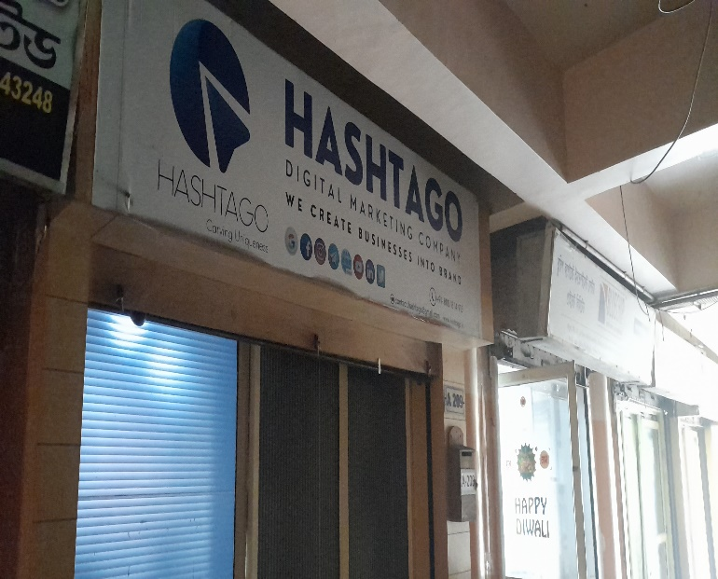



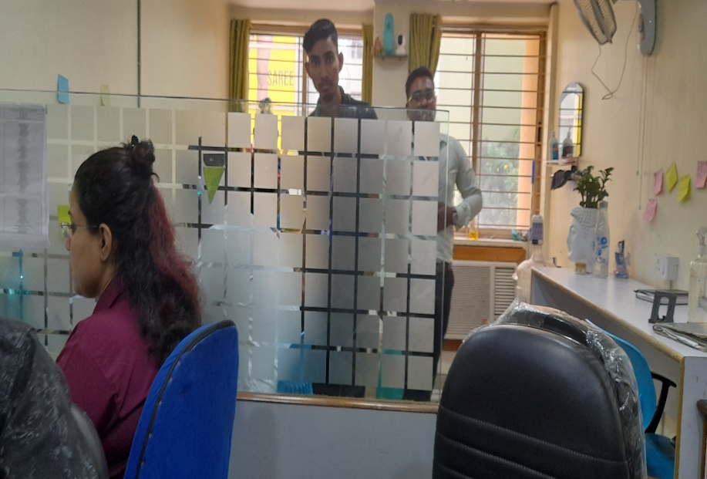
ABOUT THE PROJECT
A Digital marketing company namely 'Hashtago Digital marketing and Website Company’ is a B2B company was chosen for the data analysis purpose. 12-months(2024)data was collected, processed and analyzed.
Objective of the project was to identify the business problems and find a way out to solve those problems to help the company to run their business in a better way.
PROBLEM STATEMENTS
2
1
2
Payment Fulfilment Delays
Communication gap and low customer retention rate

Slide 3

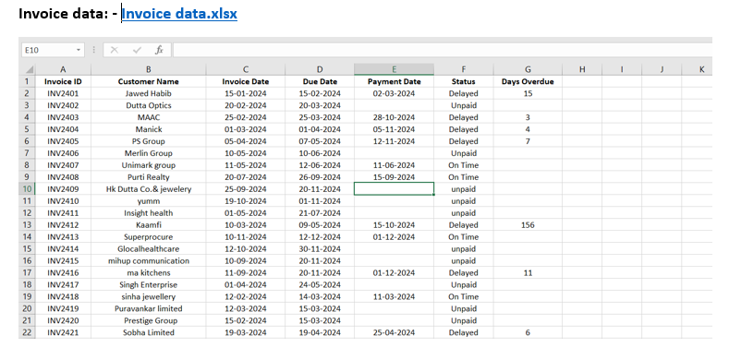
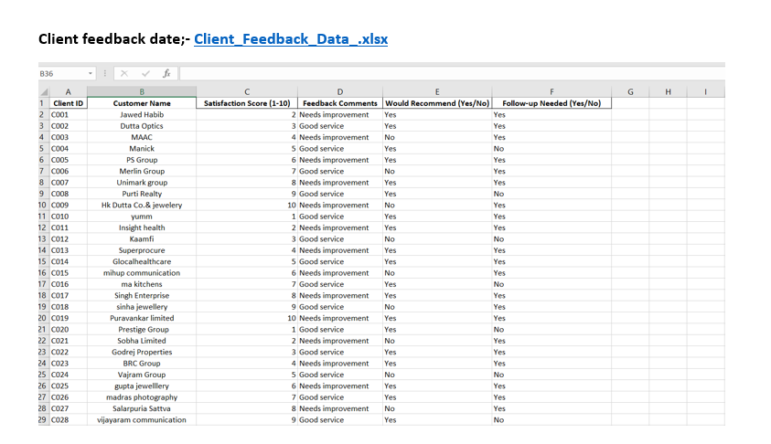
DATA COLLECTED
Time Period of Data Collected : 12-months (January 2024 to December 2024)
INVOICE DATA
CLIENT FEEDBACK DATA
Invoice data:-: Maintains records of all the transactions, i.e., the invoice dates, due dates, payment status, and overdue days.
Client Feedback Spreadsheet: Contains customer satisfaction scores, textual feedback, and follow-up requirements.

Slide 4
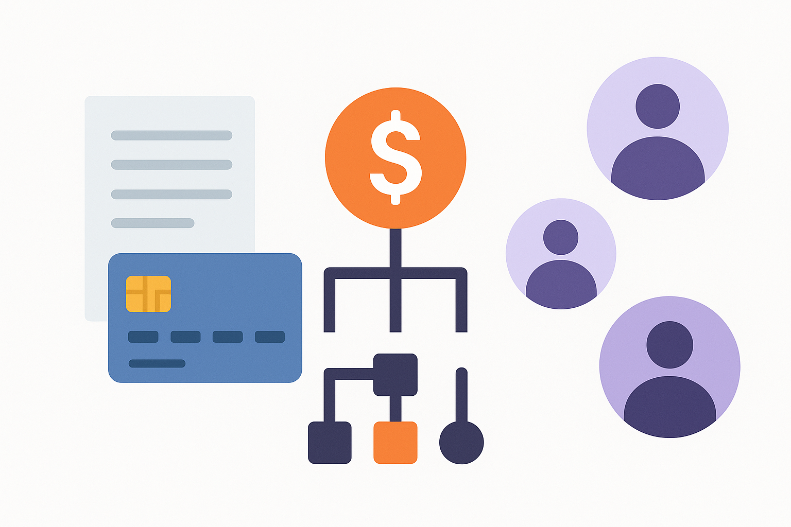


PROBLEM SOLVING APPROACH
By identifying payment patterns:- We can recognize recurring payment delays using bar charts and pie charts and identify best payment terms. Examining transaction data brings to light patterns and correlations between specific payments and delays. This allows the company to make precise improvements to billing procedures, select improved payment options, and increase payment fulfillment efficiency overall.
. Conducting Regular Payment Audits;-with tools like Google Collab for data processing and visualization platforms like Tableau, Excel, or Power BI for trend analysis will allow Hashtago to proactively address overdue accounts by visualizing cash flow gaps.
Implementing Customer Feedback Mechanisms:-To bridge the communication gap and customer retention level, we shall interpret client feedback data through the use of visualization tools such as bar charts, pie charts, and line graphs. Bar charts will be used to compare different services' levels of satisfaction, while pie charts will show the percentage of categories of feedback (e.g., positive, negative, neutral). Line graphs will monitor changes in client sentiment across time, picking out trends and patterns. These visualizations will reveal key problems, identify commonly discussed issues, and identify areas of improvement. With these insights, specific strategies can be crafted to improve communication, individualize client interactions, and ultimately improve retention rates.

Slide 5

ANALYSIS PROCESS
Collection of invoice data and client-feedback data is done from the company and after that data cleaning is done followed by;-
Pre-processing :
Data entered manually
Paste-Transpose function used
Various formulas used to easily enter data and to get weekly data of revenue sheet
Descriptive Analysis
Histograms were employed to analyze client payment and satisfaction trends. The majority of delayed payments for overdue cases fell between 3 and 15 days, with some outliers up to 156 days, which forms a right-skewed distribution. What this indicates is that the majority of clients delay moderately, but a minority of them present serious cash flow problems and require tighter follow-up or credit policy adjustments.
For client satisfaction, most of the scores were between 3 and 8, with a mean of 5.5, which represents moderate satisfaction. The slight right-skewness indicates that while numerous clients are moderately satisfied, there is a discernible number who are dissatisfied. There is an urgent need to enhance service and prevent client churn.
Diagnostic Analysis
Payment Issues Identified pie charts and line graphs in Python (Google Collab) indicated 45% unpaid and 27% overdue bills, with delays greatest during exam months.
Client Dissatisfaction Tracked histograms and pie charts indicated most satisfaction ratings were mid-range, and 40% wouldn't recommend the company—emphasizing bad follow-up and communication lapses.

Slide 6
ANALYSIS PROCESS
Python Application in Analysis:-:
Python libraries such as Pandas, NumPy, Matplotlib, Seaborn, Scikit-Learn, Statsmodels, TextBlob, and NLTK were utilized for statistical analysis (mean, median, standard deviation, ANOVA, correlation), predictive modelling (logistic regression), sentiment analysis on client feedback, and data cleaning.
Visualization methods like line graphs (payment trends) and boxplots (delayed payments) were made using Python within Google Collab to gain better insights into trends and client patterns.
Predictive Analysis: -Predicting The future behaviour-
Logistic Regression and Sentiment Analysis: Logistic regression was used to predict, with 80–90% accuracy which clients will pay late, based on characteristics such as past payment history, days overdue, and client feedback scores. Further, sentiment analysis of client feedback identified early hints of dissatisfaction so that intervention could be made before it became an issue.
Machine learning methods assisted in classifying customers as high-risk or low-risk, and churn prediction was done using historical follow-up records and satisfaction scores to detect potential client losses.
Prescriptive Analysis; -Providing actionable recommendations-
Adaptable strategies such as early payment discounts, automated reminders, dynamic credit policies, and individualized engagement plans were proposed to enhance timely payments and customer relationship building.
Sentiment analysis and AI chatbots were proposed to monitor customer satisfaction trends and address repetitive questions instantaneously, enhancing client communication and service speed overall.

Slide 7
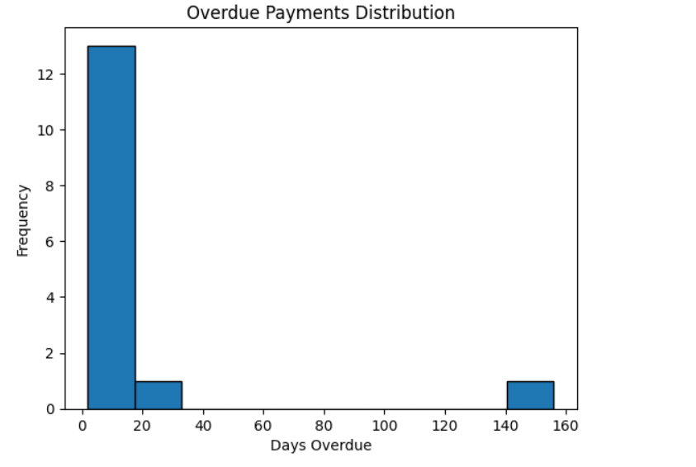
RESULTS
The following section provides most notable findings obtained through the analysis of Hashtago's invoice and customer feedback information. Visuals like histograms, pie charts, and line graphs show trends in payment trends and customer satisfaction affecting the business of the company.
INVOICE DATASET ANALYSIS
Figure 1
Figure 2
The analysis of Hashtago’s invoice data reveals several key insights that directly impact the company's financial stability .Figure 1 shows that a substantial proportion of invoices were either unpaid (45%) or overdue (27%), posing a serious cash flow challenge
Figure 2 highlights a right-skewed distribution in overdue payments, where most delays occurred between 3–15 days, but a few clients delayed payments up to 156 days, significantly skewing the overall cash collection.
The above two analysis shows Hashtago faces serious cash flow issues due to a high percentage of unpaid and overdue invoices. Most delays are short-term, but extreme overdue cases significantly distort the overall financial health. Immediate measures are needed to control both frequent minor delays and rare but severe payment defaults.

Slide 8
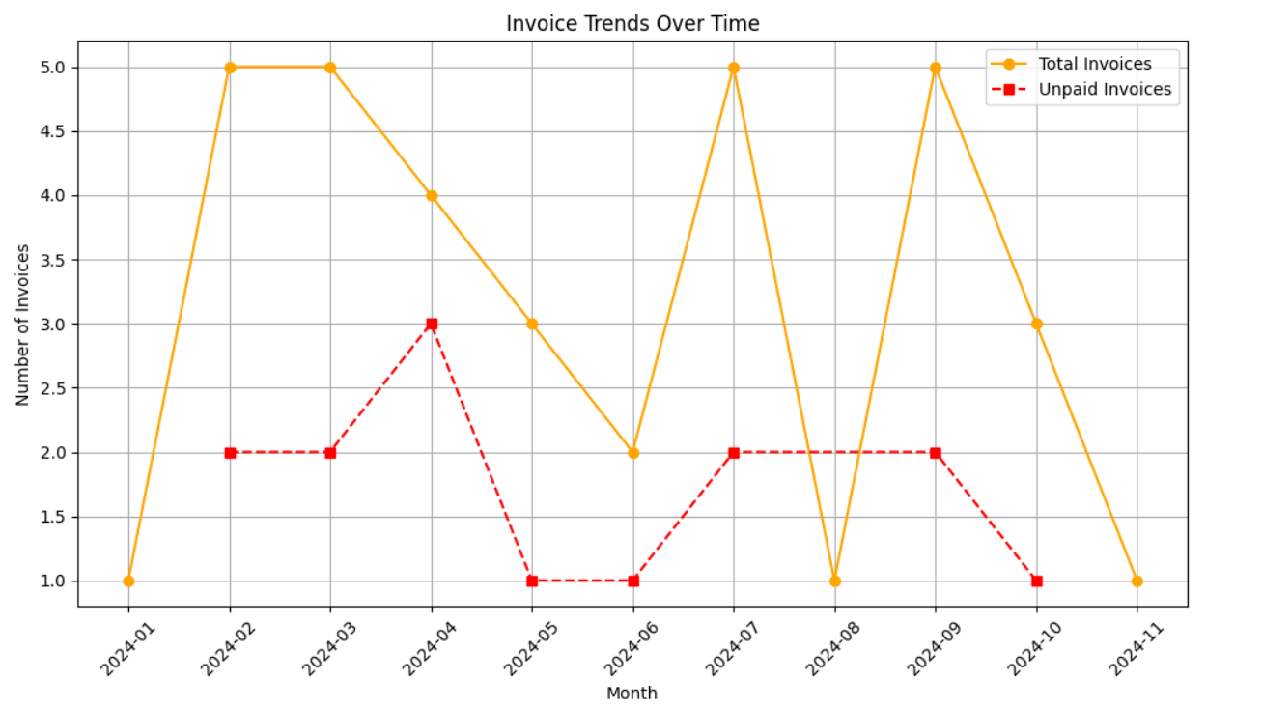
RESULTS
The chart shows two trends for 2024: total invoices issued each month (orange line) and unpaid invoices (red dashed line). Invoice issuance fluctuated, with peaks in February, April, August, and October, indicating periods of higher business activity. Unpaid invoices spiked in months like April and July, despite high issuance, while August saw fewer unpaid invoices, suggesting better payment collections during that time.
The pattern of unpaid invoices indicates that delays are client-specific rather than seasonal. Even during busy months, unpaid invoices can rise if collection strategies are weak. To improve cash flow, proactive follow-ups and early payment incentives should be emphasized in high-activity months, like April and October. Tracking both trends helps identify periods of increased cash flow risk.
INVOICE DATASET ANALYSIS
Figure 3
“”””The invoice data analysis for Hashtago revealed major concerns related to payment delays and customer behavior. A significant proportion of invoices were either unpaid or overdue, with the majority of overdue payments falling within a 3–15 day window, though extreme outliers were also present. Identifying high-risk customers based on their late payment patterns has enabled better targeting for follow-ups and risk management. The trends indicate that Hashtago’s cash flow challenges are not purely based on sales volume but largely depend on payment collection efficiency. High invoice issuance months often coincide with a rise in unpaid invoices, signaling a need for stronger credit control and follow-up practices. Payment behavior varies significantly across clients, making targeted client-specific interventions essential to reduce overdue payments and maintain financial stability.””””

Slide 9
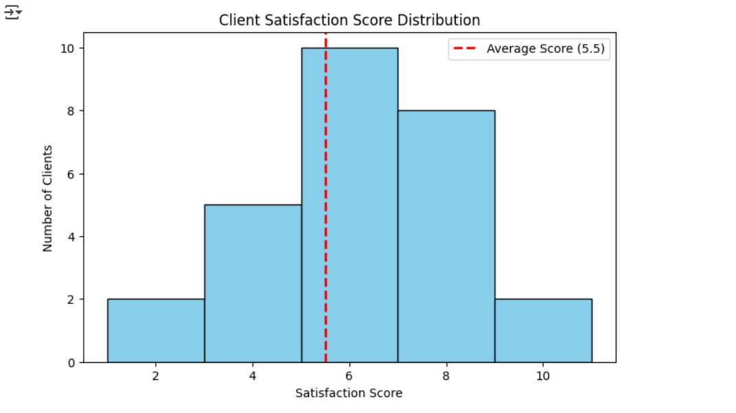
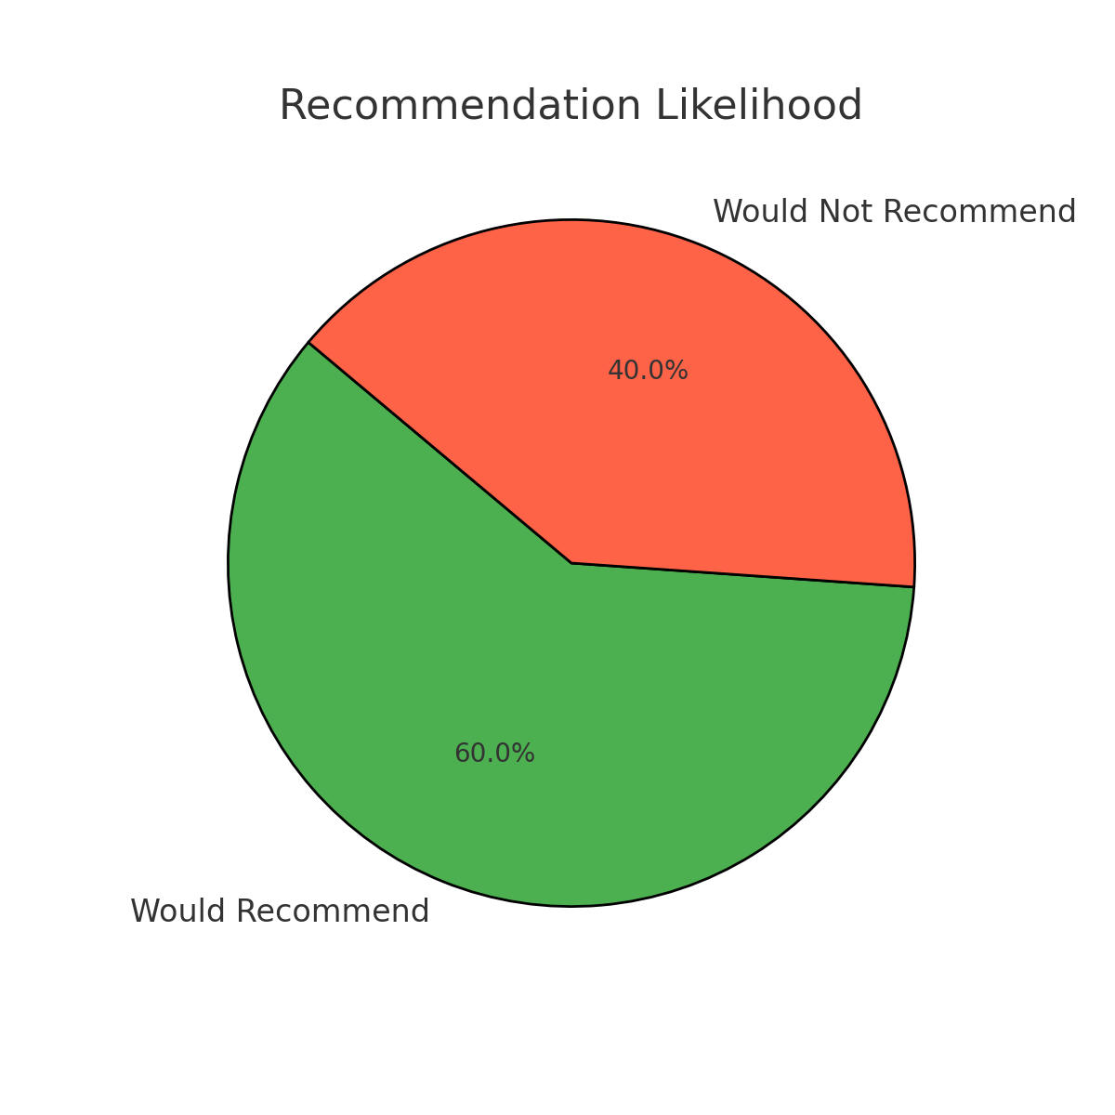
RESULTS
Client feedback dataset analysis
Figure 4
Figure 5
Figure 4 presents the distribution of client satisfaction scores. The scores ranged from 1 to 10, with the majority of clients providing ratings between 3 and 8. The average satisfaction score was approximately 5.5. The distribution appeared slightly left-skewed, indicating that while extreme dissatisfaction was relatively rare, most customers rated their satisfaction as moderate rather than high. This skewness suggests that although complete dissatisfaction is uncommon, true client delight is also not widespread. In an ideal scenario, a more symmetrical distribution centered around higher scores would reflect a more consistently positive customer experience.
Figure 5 shows the proportion of clients willing to recommend Hashtago. Sixty percent of clients stated they would recommend the company, while forty percent indicated they would not. Although the majority response is positive, the relatively high percentage of clients unwilling to recommend points to significant areas for service improvement. A higher recommendation rate would generally be associated with stronger brand loyalty and organic client acquisition through referrals.

Slide 10
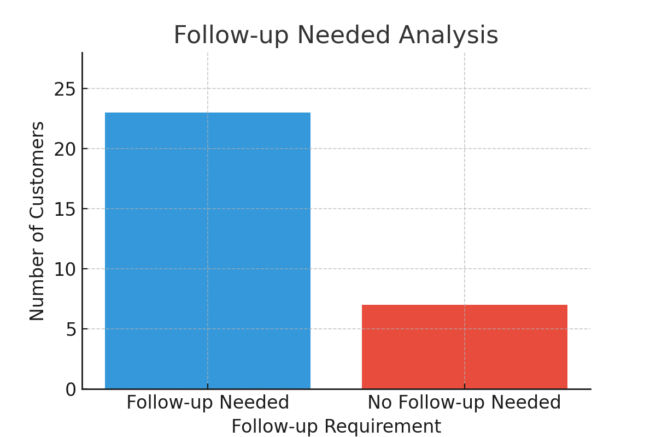
RESULTS
Figure 6 analyzes the requirement for client follow-up communication. The findings revealed that a large proportion of clients required additional follow-ups after the initial engagement. This concentration suggests a communication gap, where clients’ needs were not fully addressed during the primary interaction. Ideally, if the communication process were more effective, the distribution would be more even, with fewer clients requiring repeated follow-ups. The need for multiple engagements can increase operational burden and reduce customer satisfaction over time.
Client feedback dataset analysis
Figure 6
The client feedback analysis shows that Hashtago needs to improve service consistency and client communication. Moderate satisfaction levels, a high follow-up requirement, and a 40% non-recommendation rate highlight clear gaps. Strengthening proactive engagement and delivering more personalized services will be crucial for improving client loyalty and supporting the company’s growth. Overall, the client feedback analysis highlights moderate satisfaction levels, significant room for improvement in client loyalty, and the urgent need to strengthen proactive client communication strategies. These findings underline the necessity for Hashtago to focus on enhancing client engagement, streamlining communication processes, and delivering consistently high service quality to foster stronger, longer-lasting customer relationships.

Slide 11




RECOMMENDATIONS
Prioritize Early Collection Efforts on High-Risk Clients: Since a small number of clients are causing extreme payment delays, focus follow-up efforts on clients with a history of overdue payments beyond 15 days, as identified in the analysis.
Segment Clients by Payment Behavior: Create separate handling strategies for clients who regularly delay payments versus those who delay occasionally, to apply appropriate payment terms and follow-up intensity.
Introduce Clear Payment Terms and Reinforce at Onboarding: As many clients contribute to short-term delays (3–15 days), setting clear expectations at the start of engagements about payment timelines can reduce confusion and minimize minor delays.
STRATEGY N°1
STRATEGY N°2
STRATEGY N°3

Slide 12
RECOMMENDATIONS
Strengthen Client Relationship Management for Low Satisfaction Clients: Identify clients who provided lower satisfaction scores or indicated a need for more communication, and assign them dedicated relationship managers to rebuild trust and improve service consistency.
Implement Structured Follow-Up Schedules: Given the significant proportion of unpaid and overdue invoices, a manual but structured follow-up calendar (weekly or biweekly) should be maintained to reduce both small and large payment delays without relying on automation
Standardize Client Communication Protocols: To address the frequent need for client follow-ups observed in feedback analysis, formalize consistent communication touchpoints throughout project delivery, ensuring clients feel informed and engaged.
STRATEGY N°4
STRATEGY N°5
STRATEGY N°6

Slide 13

THANK YOU

